Slide 1
Clause H1 Update 2021
Rob Campion
3rd December 2021
Notes:
Welcome to this short presentation on the recently released update to clause H1 of the Building Code…

Slide 2
Clause H1 Update
Notes:
A little background to start. So, H1 is the Clause of the Building Code that regulates the Energy Efficiency of our built environment.
It “Provides for the efficient use of energy and sets physical conditions for energy performance.” and was last amended in November 2019

Slide 3
Clause H1 Update
Notes:
MBIE put out a Consultation Document in April this year, seeking comment on a series of proposed changes.

Slide 4
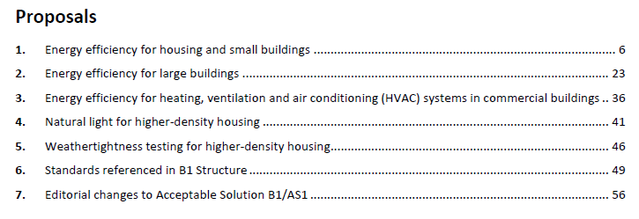
Clause H1 Update
Notes:
The Consultation was divided into seven parts,
- Parts 1 – 3 referred to Clause H1 – Energy Efficiency
- Part 4 referred to Clause G7 - Natural Light
- Part 5 is Clause E2 – External Moisture
- Part 6 & 7 referred to Clause B1 - Structures
Parts 1 and 2 will be our focus for this presentation, and have the greatest impact on the window and glass industry…

Slide 5
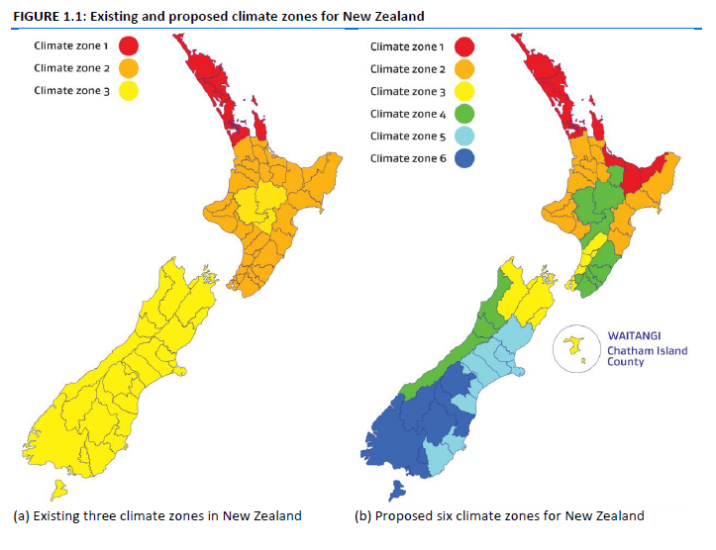
Clause H1 Update
Notes:
One part of the proposal was to shift from the existing three Climate Zones to a proposed six…
Which makes sense, if you consider in the previous map the climates in Queenstown, Westport, Christchurch, and Nelson were all considered in the same way…

Slide 6
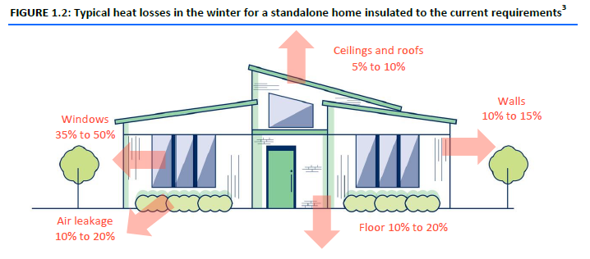
Clause H1 Update
Notes:
We were also reminded where winter heat was typically lost in a standalone home…
We’ve always known that the windows are the weak point in the thermal envelope. Under the existing performance requirements where we had R0.26 for a window vs R1.9 for a wall… (~700% difference), so no surprises here…

Slide 7
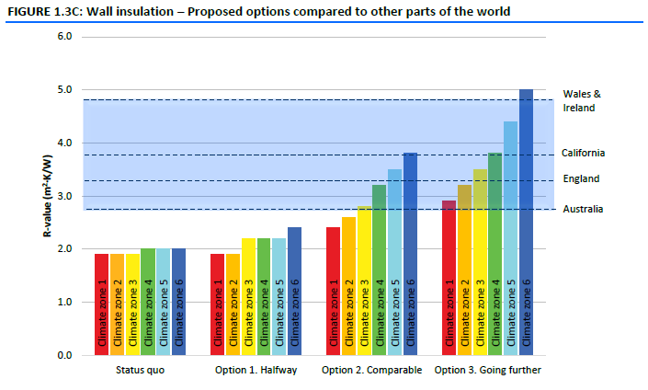
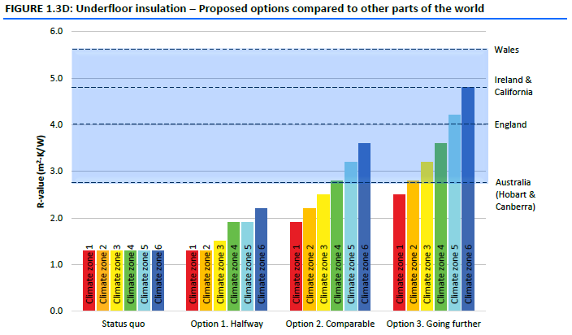
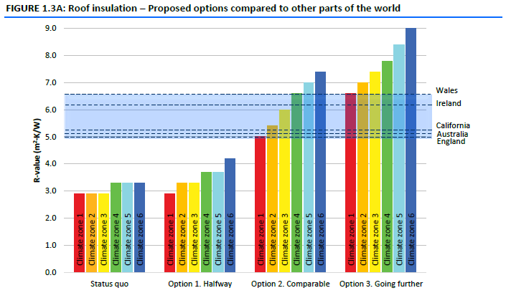
Clause H1 Update
Notes:
And we were introduced to graphs like these that compared our current levels of thermal performance, for each of the primary building elements (Floors, Roofs, Walls), to those from other parts of the world, and we were offered three options for moving forward for each element.
At this point we are starting to directly relate Thermal Performance with Energy Efficiency… i.e. increased thermal resistance provides for increased energy efficiency…

Slide 8
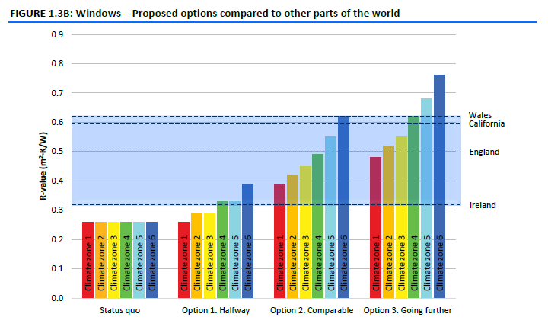
Clause H1 Update
Notes:
Of course the graph we are most interested in is this one, for windows…
Our existing performance requirements are shown on the left and the blue band across the top provides an indication of the requirements from Countries with similar climates to our own.
And three performance options were proposed…

Slide 9
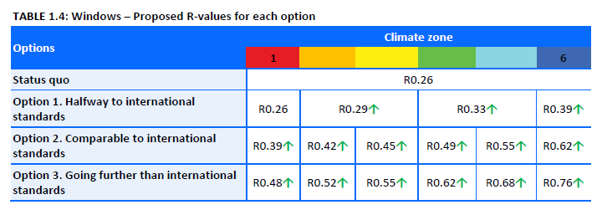
Clause H1 Update
9
Notes:
A series of meetings were held across industry, where it was agreed that the WGANZ submission, on behalf of the industry, would reflect a preference for Option 2, and
That we, the industry, could achieve this transition within 24 months (Option B)

Slide 10
Clause H1 Update
Notes:
Previously, Clause H1 had been relatively short and had mostly referred to this Standard – NZS 4218.

Slide 11
Clause H1 Update
Notes:
The new update brings NZS 4218 into its body and modifies it as a first step toward the Governments BfCC programme.
Please note, this is definitely only the first step and there is more change to come, which we’ll touch on a bit later…

Slide 12
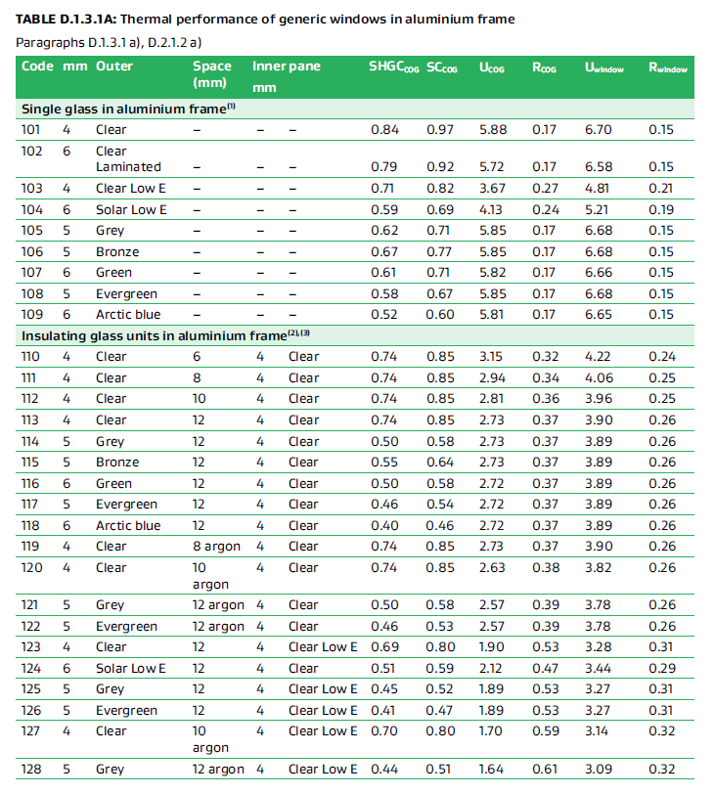
Clause H1 Update
Notes:
One of the consultation inclusions was a leftover from NZS 4218 – the thermal performance tables for generic windows.
These were old and out of date when they were published in 2009 and are even less appropriate to this update and any proposed steps forward.
Not only because it included brand names and glass types that are no longer commonly used, …

Slide 13
Clause H1 Update
1800
1500
Notes:
But also because of the way the data was calculated and used.
Traditionally we have considered the thermal performance of windows based on this configuration, which at the time it was developed was seen as the mean of a houselot of windows and doors.
We proposed in our submission that this methodology was no longer appropriate and that we should be looking at a weighted average calculation for thermal performance.

Slide 14
Clause H1 Update
Notes:
So we completed our submission and sent it away.
The submission was well considered by MBIE and we engaged in a conversation to correct some of the issues raised.

Slide 15
Clause H1 Update
Notes:
We worked with both MBIE and BRANZ on a replacement for the old NZS 4218 tables. As mentioned, we proposed moving from the single window methodology to a more meaningly philosophy based around the weighted average of a houselot of windows and doors. This meant initially gathering some data on what a typical or average houselot of windows and doors looked like today, rather than basing it on older data.

Slide 16
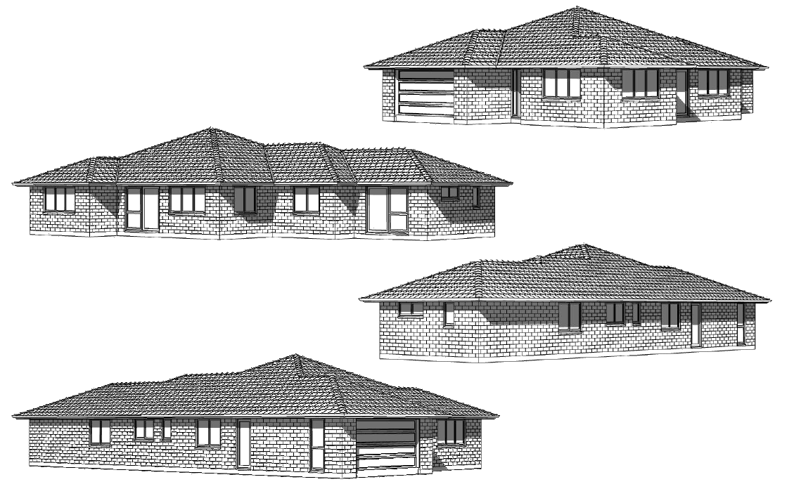
Clause H1 Update
Notes:
To start we approached some group home builders and requested copies of their most popular plans, as an indication of what was being built today. We started with three plans and built them into a spread sheet…

Slide 17
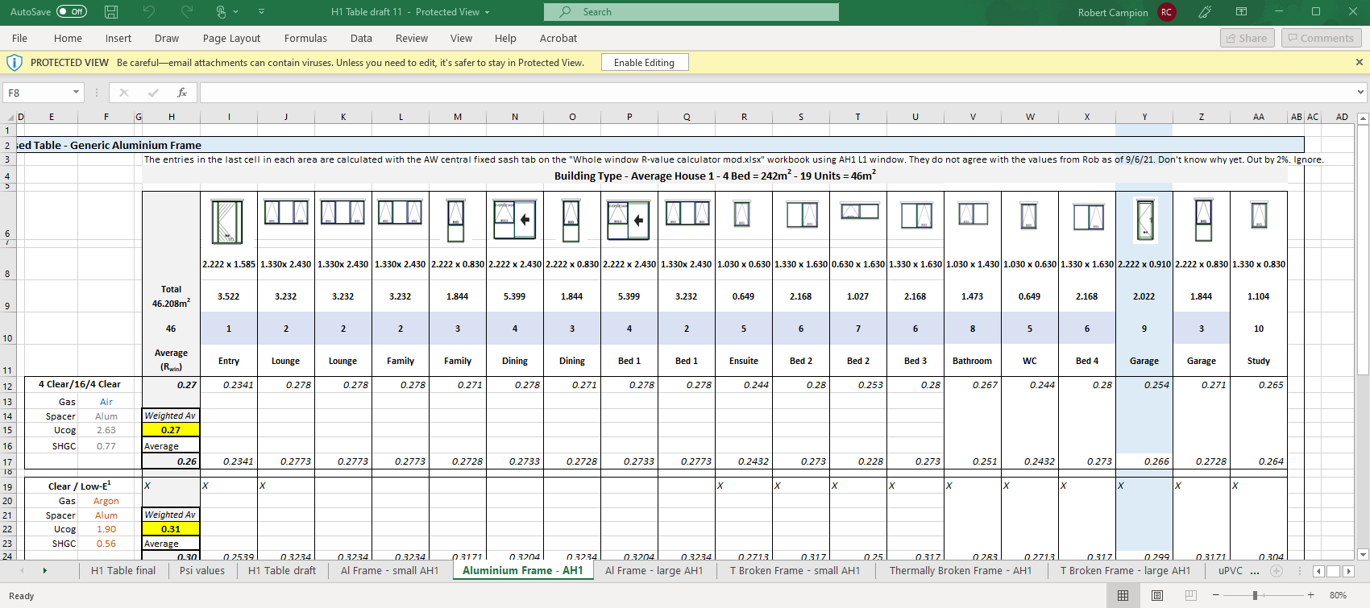
Clause H1 Update
Notes:
We first calculated the area of each unit, and
Then the thermal performance for each frame and glazing combination, for each unit across the houselot which was then averaged.
This was repeated for each houselot with each of the four common frame materials (aluminium, thermally broken aluminium, uPVC, and timber) across 11 different standardised glass options, which were provided to us by industry members.
The theory was that each model should return a similar average R value for each houselot.
To further prove the theory, at MBIE’s request, we developed three more unusual houselots to understand what the total variance might look like…

Slide 18
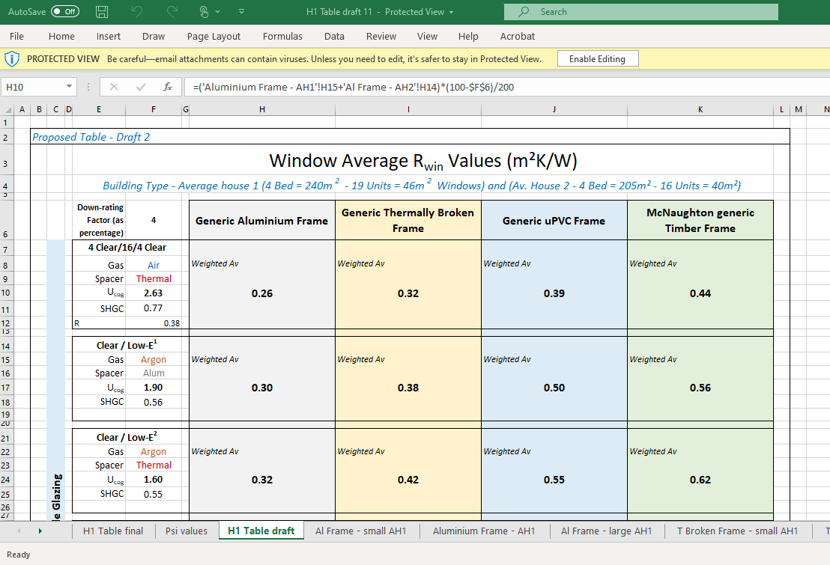
Clause H1 Update
Notes:
And from there, this table was created and submitted as an alternative to the NZS 4218 version proposed for the H1 update.

Slide 19
Clause H1 Update
Notes:
Whilst working through the table development, we were contacted regarding our submission and called to a meeting to discuss an alternate time frame from the two years we had proposed…
MBIE were keen to discuss ways of introducing better window performance in a shorter time frame…

Slide 20
Clause H1 Update
20
Notes:
Understanding that the upcoming release was only to be a first step in the process, and that further (more complex change was ahead) it was proposed that the climate zones be grouped, 1&2, 3&4, 5&6 and…
It was discussed that a reduction in the required performance values would allow manufacturers and suppliers to adjust their production and supply chains to focus better performing window frames into the areas that needed it most, whilst their supply capabilities were built up…
Figures of R0.37, R0.46, and R0.50 were settled upon…

Slide 21
Clause H1 Update
Notes:
Changes to a Code Clause require consultation, and now that we were trying to make changes after the initial public consultation, meant that the document (including the additions) would have to go out for consultation again, extending the process and delivery times…
However MBIE had a strategy that allowed the document for this…

Slide 22
Clause H1 Update
Notes:
MBIE arranged a series of targeted consultations, with consultants, industry, and other interested parties to discuss the proposed changes. One of these was held for each of the four elements in the Code, Floors, Roofs, Walls, and of course Windows…

Slide 23
Clause H1 Update
Notes:
For windows the adjustment to the performance of window requirements was put to the group…

Slide 24
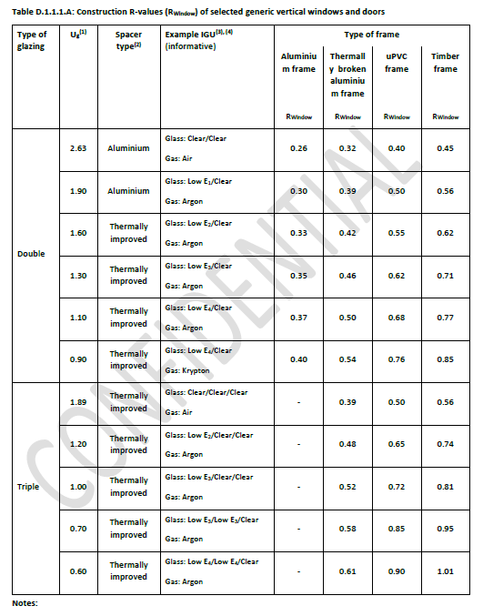
Clause H1 Update
Notes:
As was the draft of the new table…

Slide 25
Clause H1 Update
Notes:
Fast forward to 29th November and the Update to Clause H1 is released…

Slide 26
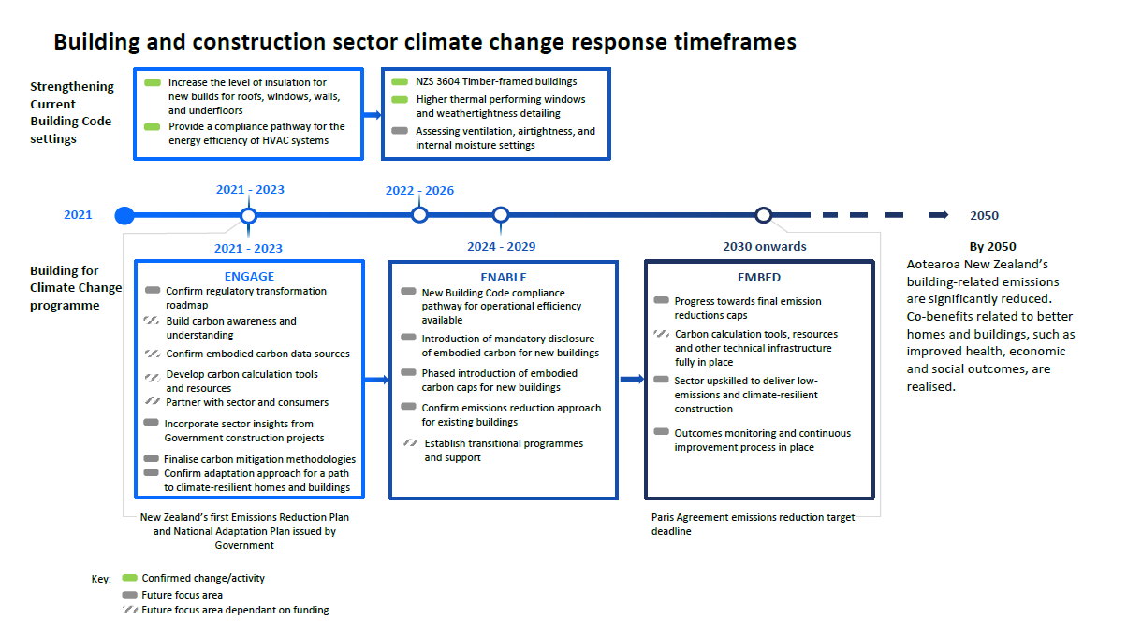
Clause H1 Update
Notes:
And possibly for the first time, we were introduced to a plan moving forward…

Slide 27
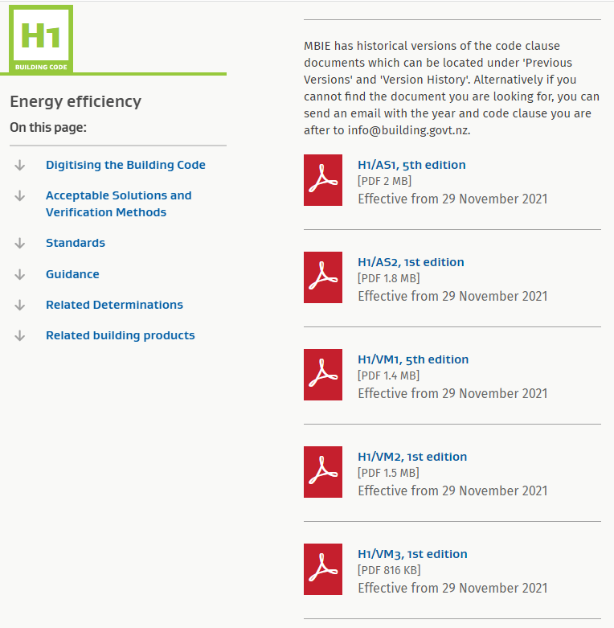
Clause H1 Update
Notes:
The release came as five separate documents, looking at different parts of the Clause…

Slide 28
Clause H1 Update
Notes:
This presentation will focus on the changes most important to the window and glass industry…

Slide 29
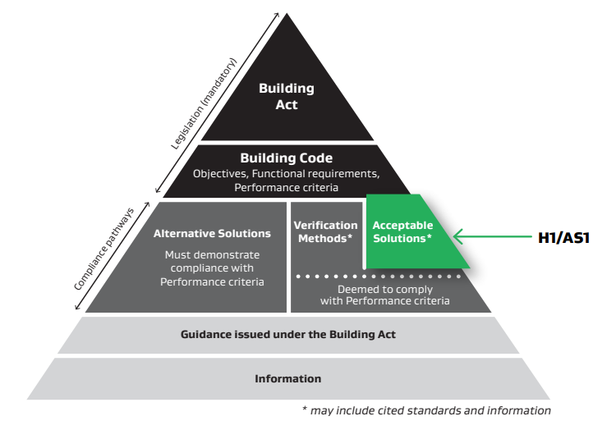
Clause H1 Update
Notes:
Before we continue lets just take a moment to understand the difference between an AS and a VM…
AS = Acceptable Solution, a solution provided by the Code…
VM = Verification Method, a method of demonstrating compliance, through testing, calculation or other methodology, with the Code, other than the AS…
Both of these are deemed to comply solutions and in theory are accepted by a TA…

Slide 30
Clause H1 Update
Climate Zones

Slide 31
Clause H1 Update
Notes:
The six climate zones have been implemented with a couple of minor changes based on local council engagement…
As noted earlier, the changes make sense but do mean that it is important to not only understand where your client base is located, but also the address of the site you are supplying to, as the minimum requirements for compliance may change considerably between Climate Zones in your supply area.
There is a table in Appendix C (Page 22) that nominates the Climate Zones by TA / region.

Slide 32
Clause H1 Update
Housing

Slide 33
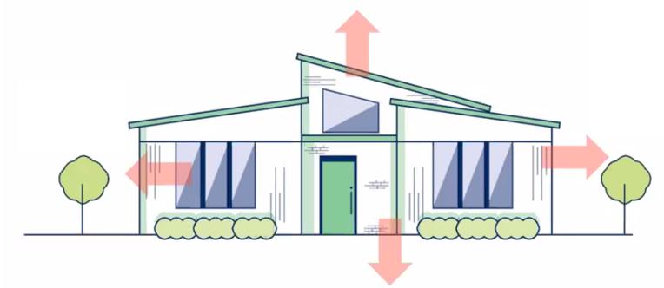
Clause H1 Update
Notes:
Starting with H1/AS1, which primarily refers to housing, regardless of size…
And to other buildings up to 300m²…

Slide 34
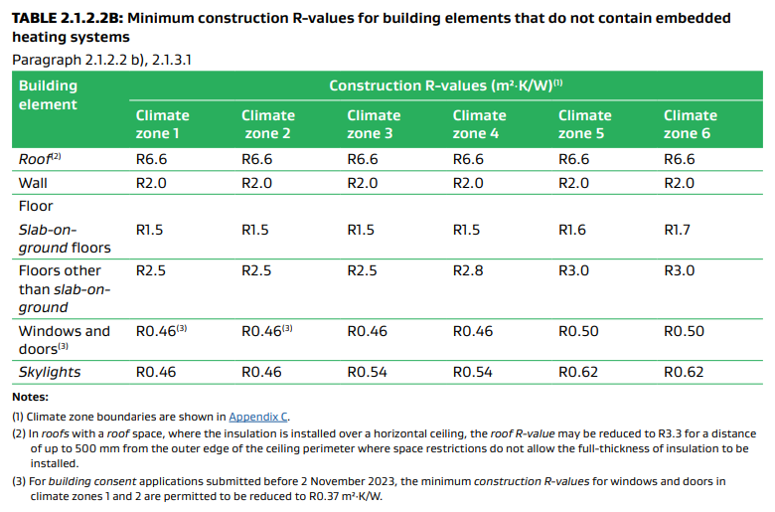
Clause H1 Update
Notes:
In terms of Housing, the new minimum construction R values required for compliance are per Table 2.1.2.2B…

Slide 35
Clause H1 Update
Notes:
But let’s look at windows specifically…

Slide 36
Clause H1 Update
Notes:
The table looks a little different to what we were expecting with the requirement of R0.46 for climate zones 1&2, and 3&4
However, there is some reprieve…

Slide 37
Clause H1 Update
After Nov 2022
R0.37
R0.37
After Nov 2023
Notes:
Note 3 refers to one year reduction /relaxing of this requirement…
To explain the transition period,
The Code and regulations are in place as of 29th November 2021 (Monday)
Compliance with these regulations is optional up until the beginning of 3rd November 2022
With a further reprieve until 2nd November 2023 for Climate Zones 1 and 2 only…
From 3rd November 2023 compliance will be required as written!

Slide 38
Clause H1 Update
Climate Zones 1 and 2 =
~60% of Population
~70% of Construction
Notes:
To put that into perspective…
Climate zones = approx. 60% of our population and almost 70% of our construction…

Slide 39
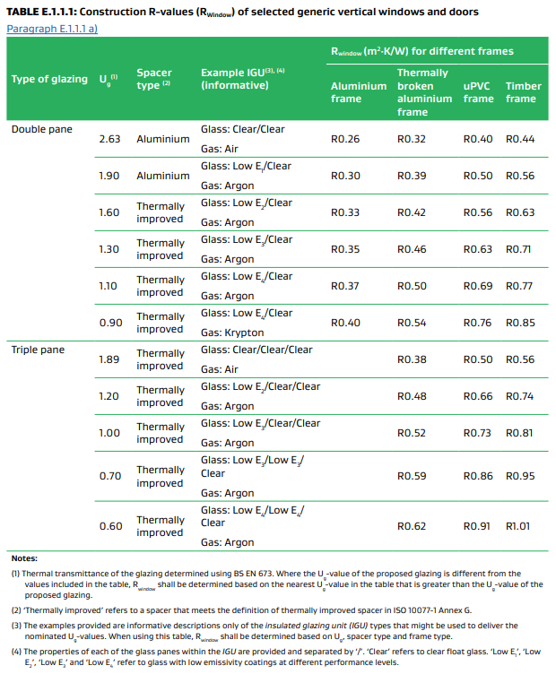
Clause H1 Update
Notes:
Table E.1.1.1 in Appendix E (Page 26) comes into play, and is the final result of the work I mentioned earlier and shows the GENERIC performance levels (R values) of the four frame materials combined with the 11 glass types based on the weighted average of a typical houselot of windows and doors…
Glazing has been split into two types, Double and Triple…

Slide 40
Clause H1 Update
Notes:
But lets remove the triple glazing for clarity for the explanation of the table…
To confirm, the intent of this table is to assist designers and architects in the selection of compliant window frame and glazing combinations, for buildings that fit within the scope of the Schedule Method in H1/AS1.
Unusual and difficult houselots will need to be calculated and/or modelled. This is a guide for the 60% of houses that fit within this category…
The U_{g} value is the focus for the glazing portion of this table and represents typically available glass make ups. The Example IGU provides an example of what the IGU make up might look like in order to achieve that value, but of course there are many possibilities
These IGU values are then applied across the four frame types to arrive at a calculated R_{window} value. So if looking to comply in a Climate Zone 3 or 4 then you can select from the combinations that achieve a value of R0.46 or better. This value is the weighted average of the windows and doors being supplied for the project.

Slide 41
Clause H1 Update
Notes:
So how does this look across the zones…

Slide 42
Clause H1 Update
Climate Zones 5 and 6
After Nov 2022
Notes:
In Zones 5 and 6 with a required R_{window} of R0.50, this series of combinations are deemed to be compliant…

Slide 43
Clause H1 Update
Climate Zones 3 and 4
After Nov 2022
Notes:
In Zones 3 and 4 with a required R_{window} of R0.46, this series of combinations are deemed to be compliant…

Slide 44
Clause H1 Update
Climate Zones 1 and 2
After Nov 2022
R0.37
R0.37
Notes:
In Zones 1 and 2, from now, but between November 2022 and November 2023 with a required R_{window} of R0.37, this series of combinations are deemed to be compliant…

Slide 45
Clause H1 Update
Climate Zones 1 and 2
After Nov 2023
Notes:
In Zones 1 and 2, after 4th November 2023 with a required R_{window} of R0.46, this series of combinations are deemed to be compliant…

Slide 46
Clause H1 Update
Climate Zones 1 and 2
After Nov 2023
NO more solid aluminium frames
and
NO more clear on clear IGU’s
Notes:
Which means…

Slide 47
Clause H1 Update
Entrance Doors

Slide 48
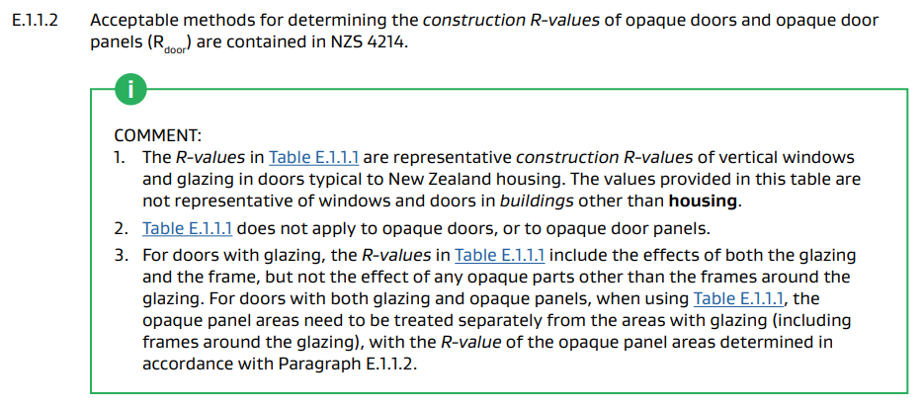
Clause H1 Update
Notes:
Entrance doors (opaque rather than glazed) also form a part of the thermal envelope and therefore should be considered…
This is referred to in the comment under E.1.1.2, which points at NZS 4214 as a method of establishing the performance of opaque materials, which have to be assessed separately to the values in Table E.1.1.1

Slide 49
Clause H1 Update
Notes:
However, paragraph 2.1.2 might be interpreted that opaque doors less than 6m² are not included in the compliant R-value requirements, when using the Schedule Method…?

Slide 50
Clause H1 Update
Skylights

Slide 51
Clause H1 Update
Notes:
Skylights are in a similar position to entrance doors in that they also form a part of the thermal envelope, except that they are specifically referred to in Table 2.1.2.2B…

Slide 52
Clause H1 Update
Notes:
A significant change here from the current requirements of R0.26-R0.31 to the table below.
It is important to understand that the overall performance calculation for a skylight and/or IGU is based on the angle of incline. The lower the angle the worse the IGU performs and the better the combination required to satisfy this demand.

Slide 53
Clause H1 Update
Notes:
So the combinations in Table E.1.1.1 does not apply here…
The R values need to be calculated in accordance with Appendix E (or as in H1/VM1)…

Slide 54
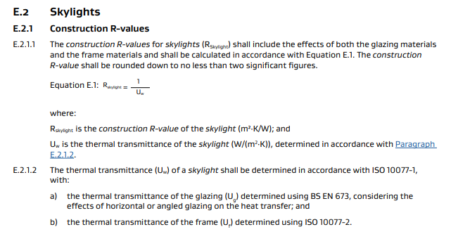
Clause H1 Update
Notes:
and the R values need to be calculated in accordance with Appendix E (or as in H1/VM1)…

Slide 55
Clause H1 Update
Notes:
Again, paragraph 2.1.2 might be interpreted that skylights less than 1.5m² are not included in the compliant R-value requirements, when using the Schedule Method…?

Slide 56
Clause H1 Update
Commercial

Slide 57
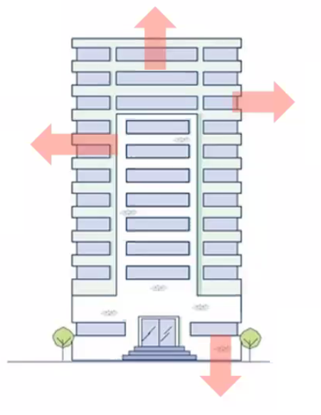
Clause H1 Update
Notes:
H1/AS2, refers to buildings (excluding housing) greater than 300m²…
Buildings like apartments and some parts of aged care facilities will still fall under H1/AS1…
Schools would fall into H1/AS2…
The addition of H1/AS2 is significant for windows in that previously there had been no Code demand for thermal performance, so this is all new…

Slide 58
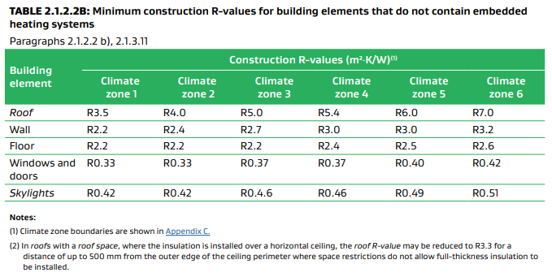
Clause H1 Update
Notes:
So, the same Climate Zones apply but with differing values to H1/AS1, some of which will be challenging to comply with, depending on the type of building, its location, its end use, and the type of window system desired.

Slide 59
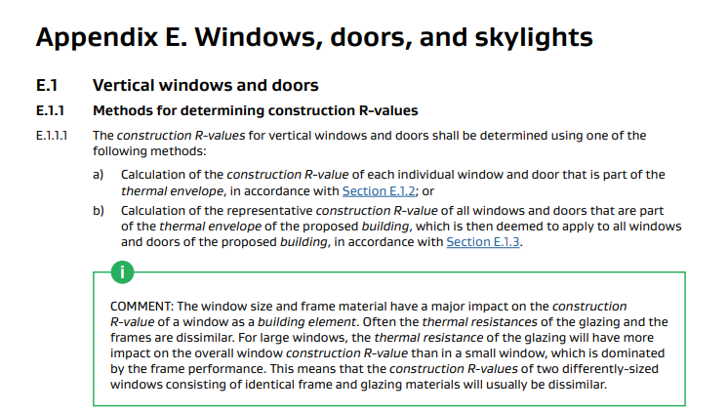
Clause H1 Update
Notes:
The Table E.1.1.1 from H1/AS1 does not apply here. Compliance is determined per the methods in Appendix E (H1/AS2) which are calculation methods. This is currently a pretty normal practice, so no change in that respect, given that many of these building will require specific design and/or the issuing of a PS1…

Slide 60
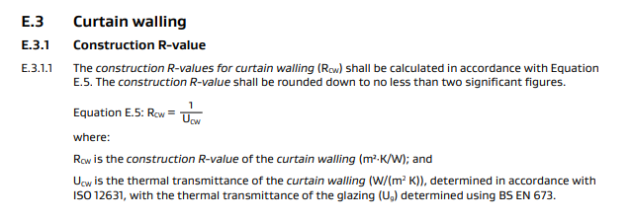
Clause H1 Update
Notes:
And curtain wall has its own methodology…

Slide 61
Clause H1 Update
Summary

Slide 62
Clause H1 Update
Summary
NZS 4218 withdrawn
Six Climate Zones, but paired for performance
Effective from 29 November 2021
Optional compliance until 3 November 2022

Slide 63
Clause H1 Update
Summary
For Housing – H1/AS1, H1/VM1,
- Zones 1 and 2 have a staged approach to compliance through to November 2023
- then only high performing frames will be compliant
- and clear on clear IGU’s will not be compliant

Slide 64
Clause H1 Update
Summary
For Housing – H1/AS1, H1/VM1,
- Skylight performance to be calculated
- Entrance door performance to be calculated
- Compliance R-value via weighted average houselot
- Referencing European Standards

Slide 65
Clause H1 Update
Summary
For Commercial – H1/AS2, H1/VM2,
- R-value requirements now apply
- No schedule in the Schedule Method
- Compliance by calculation
- Curtain wall excluded from H1/AS2, refer to
H1/VM2

Slide 66
Clause H1 Update
Thank you
If you have any comments or questions please contact,
Rob Campion at
robert.campion@wganz.org.nz

